Slide 1
Welcome to Himilcon’s lab for EDUC 275B (Data II)!
Thursdays 1-3 PM Berkeley Time
Lab 1
Thursday, January 25, 2024
Himilcon Inciarte
himilcon_Inciarte@berkeley.edu

Slide 2
Objectives
Introductions
About labs
Lab01.do
Practice time
Preview

Slide 3
Introductions
Name
Pronouns
Year & Program
Research interests
Why Data II?

Slide 4
Introductions
Himilcon Inciarte
He/Him
Third year PhD in Social Research Methodology
Explanatory IRT; Early reading development in Spanish/English bilingual populations

Slide 5
About labs
Develop skills in Stata
Preview and review homework and projects
A note about office hours
Note that many slides have been adapted from previous GSIs. They get all the credit if they’re good; I get all the blame if they’re not!

Slide 6
Today’s review

Slide 7
Statistics
Statistics consist of a body of methods for obtaining data and analyzing data.
Statistics provides methods for
Design: Planning how to gather data for research studies
Description: Summarizing the collected data
Inference: Making predictions based on the data

Slide 8
Population
The population is the total set of subjects of interest in a study.
A (population) parameter is a numerical summary of the population.
In one population, μ (population mean) and σ² (population variance) are parameters.

Slide 9
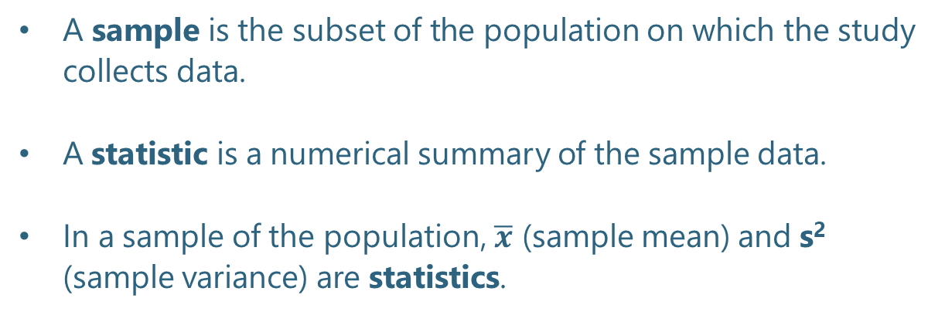
Sample
A sample is the subset of the population on which the study collects data.
A statistic is a numerical summary of the sample data.
In a sample of the population, $\overline{x}$ (sample mean) and s² (sample variance) are statistics.

Slide 10
Descriptive Statistics
Descriptive statistics summarize the information such as:
frequency;
proportion;
mean;
and standard deviation
in a collection of data, by using numbers, tables, and plots.

Slide 11
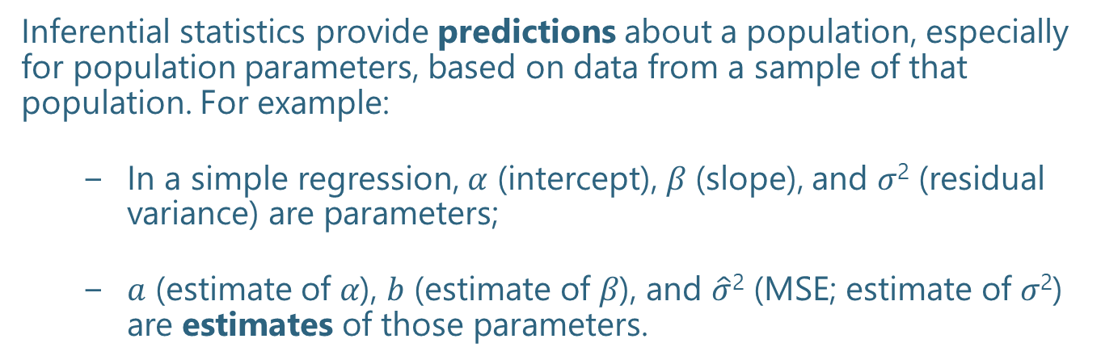
Inferential Statistics
Inferential statistics provide predictions about a population, especially for population parameters, based on data from a sample of that population. For example:
In a simple regression, 𝛼 (intercept), 𝛽 (slope), and 𝜎² (residual variance) are parameters;
𝑎 (estimate of 𝛼), 𝑏 (estimate of 𝛽), and $\hat{σ}$² (MSE; estimate of 𝜎²) are estimates of those parameters.

Slide 12
Hypothesis Testing
Hypotheses tests use sample data answer questions like the following:
Is the population mean greater than or less than a particular value?
Are the means of two or more populations different from each other?

Slide 13
Hypothesis Testing
Make decision regarding null hypothesis:
Reject or fail to reject (null hypothesis can’t be proven)
Calculate the Confidence Interval (CI) of your estimate

Slide 14
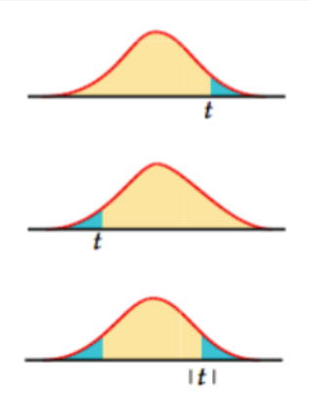
What is P-value
The p-value is defined as the probability, assuming the null hypothesis is correct, of obtaining a result equal to or more extreme than what is observed.

Slide 15
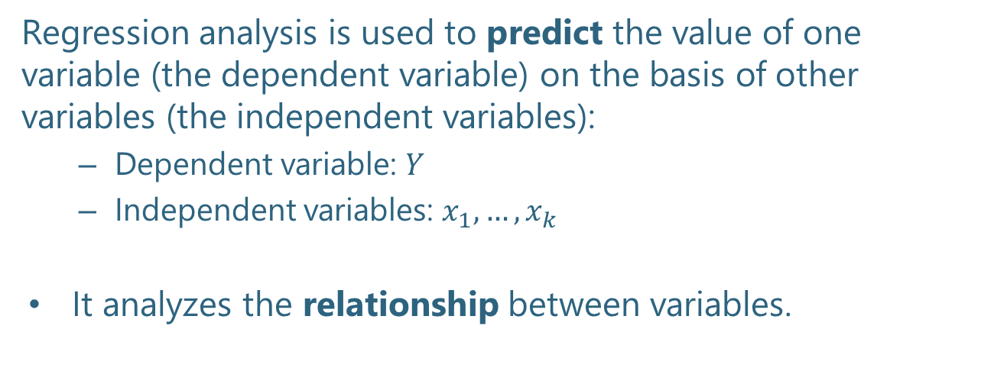
Regression analysis
Regression analysis is used to predict the value of one variable (the dependent variable) on the basis of other variables (the independent variables):
Dependent variable: $Y$
Independent variables: $x_{1}, …, x_{k}$
It analyzes the relationship between variables.

Slide 16

Simple linear regression model
A straight-line model with one independent variable is called a simple linear regression model. It is written as:
dependent
variable
independent
variable
y- intercept
slope of the line
unobserved error
$$ε_{i} \sim N(0, σ^{2})$$
identically independently normally distributed

Slide 17
Simple linear regression
Both α and β are population parameters which are usually unknown and hence estimated from the data.
y
GPA
RT
=slope (=GPA/RT)
=y-intercept
x

Slide 18
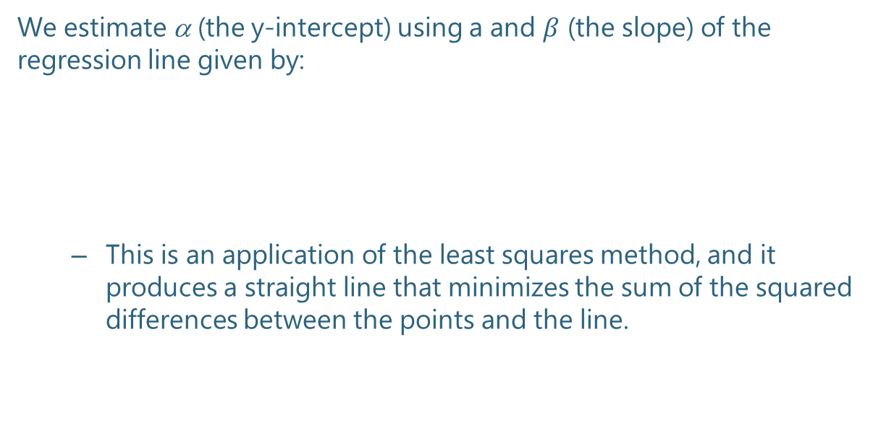
Estimating the coefficients
We estimate α (the y-intercept) using a and $β$ (the slope) of the regression line given by:
This is an application of the least squares method, and it produces a straight line that minimizes the sum of the squared differences between the points and the line.

Slide 19
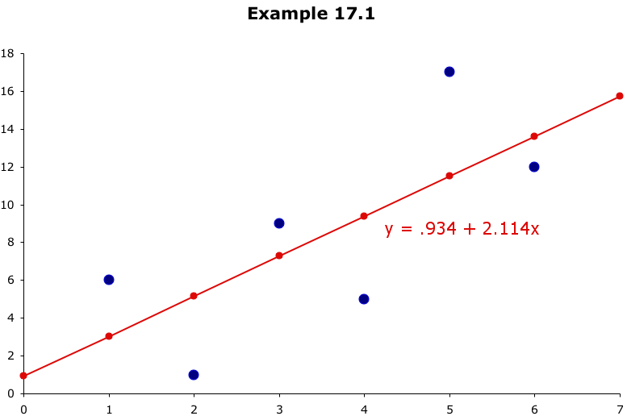
Least squares line
these differences are called residuals
This line minimizes the sum of the squared differences
between the points and the line.
Notes:
Best fitted line, regression line

Slide 20

Model assumptions
$$ε_{i} \sim N(0, σ^{2})$$
Linearity of dependent variable (Y) and independent variables (x_{i})
Residuals:
normally distributed
constant variance → homoscedasticity
mutually uncorrelated

Slide 21
Using Stata

Slide 22
eLumin Virtual Machine
Access remote desktop
Connect to Google Drive
Sign in with Browser
Success! (Pop-up Window)
Set up a folder on Google Drive
Download lab01.do ﬁle & instruction.dta from Bcourse and save it to your Google Drive folder
Open StataBE 17

Slide 23
Setup
Step 1: Go to bCourses
Step 2: Download instruction.dta, lab01.do, and instruction_codebook.pdf
Step 3: Read the pdf and open do file in Stata

Slide 24
Interpreting Stata Output

Slide 25
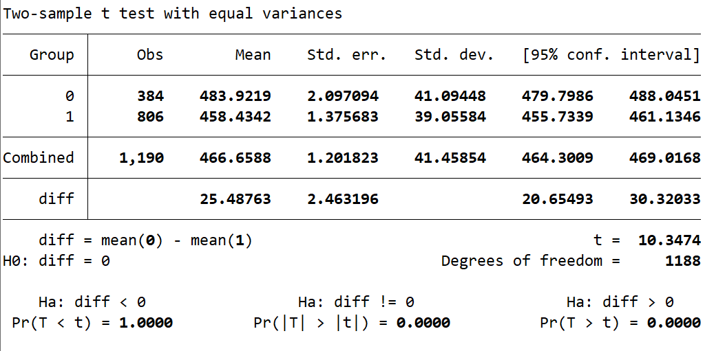
t-test
Independent samples t-test examines the differences between minority and non-minority students on mean math scores.

Slide 26
t-test
Are there are significant differences between male and female students on mean math scores?

Slide 27

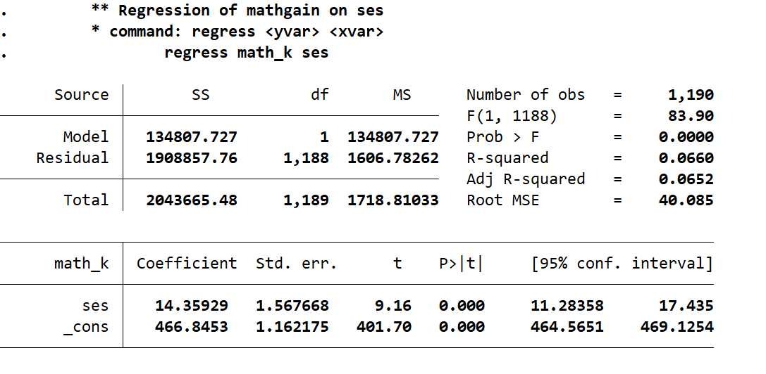


Simple linear regression model

Slide 28
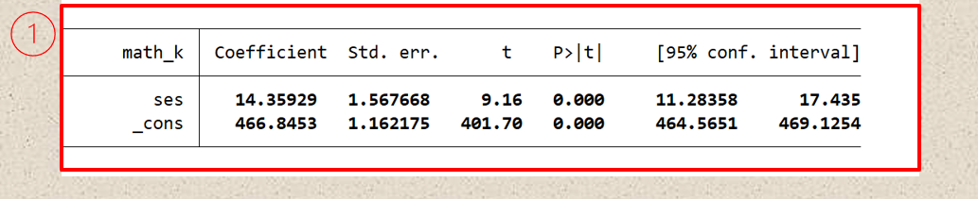
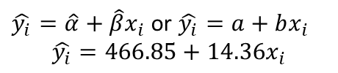
Regression output in Stata
Y: math achievement score in the spring of the kindergarten year
X: socioeconomic status
$\hat{y_{i}}=\hat{α}+\hat{β}x_{i}$ or $\hat{y_{i}}=a+bx_{i}$
$$\hat{y_{i}}=466.85+14.36x_{i}$$
INTERPRETATION: For every one unit increase in ses, the mean math_k is estimated to increase by 14.36

Slide 29


Regression output in Stata
INTERPRETATION: Since p-value is smaller than 0.05, we can reject the null hypothesis at the 5% level of significance.
=> “slope is statistically significant”
s.e.($\hat{β}$)=1.57
s.e.($\hat{α}$)=1.16
t test statistics for testing the slope
H₀:β=0 and H_{a}:β≠0
$$t=\frac{\hat{β}}{se(\hat{β})}=\frac{14.36}{1.57}≈9.16$$

Slide 30



Regression output in Stata
INTERVAL ESTIMATES
POINT ESTIMATES
$$\hat{β}=14.36$$
$$\hat{α}=446.85$$
$$11.28<β<17.44$$

Slide 31
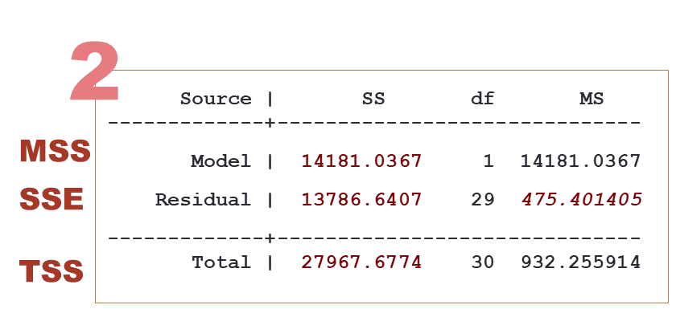

Regression output in Stata - ANOVA Table
MS = SS / df
MMS MSE
We can partition the variation in y into two
parts:
Variation in y = SSE + MSS
Sum of Squared Errors (SSE): measures the amount of variation in y that remains unexplained (i.e., due to error)
Model Sum of Squares (MSS): measures the amount of variation in y explained by variation in the independent variable x.

Slide 32
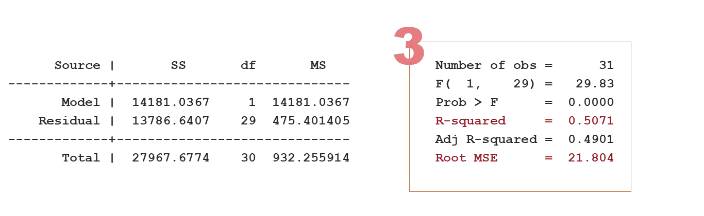

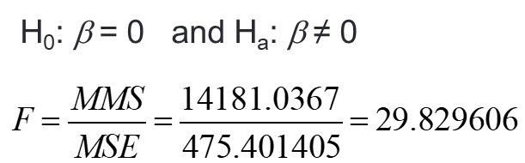

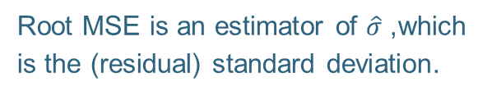
Regression output in Stata - ANOVA Table
MMS MSE
F test statistics for testing the slope
50.71% of the variation in y is explained by the variation in x. The remaining 49.29% is unexplained, due to error.
Same results as t-test:
We can reject the null hypothesis
Root MSE is an estimator of $\hat{σ}$, which is the (residual) standard deviation.

Slide 33
Practicing

Slide 34
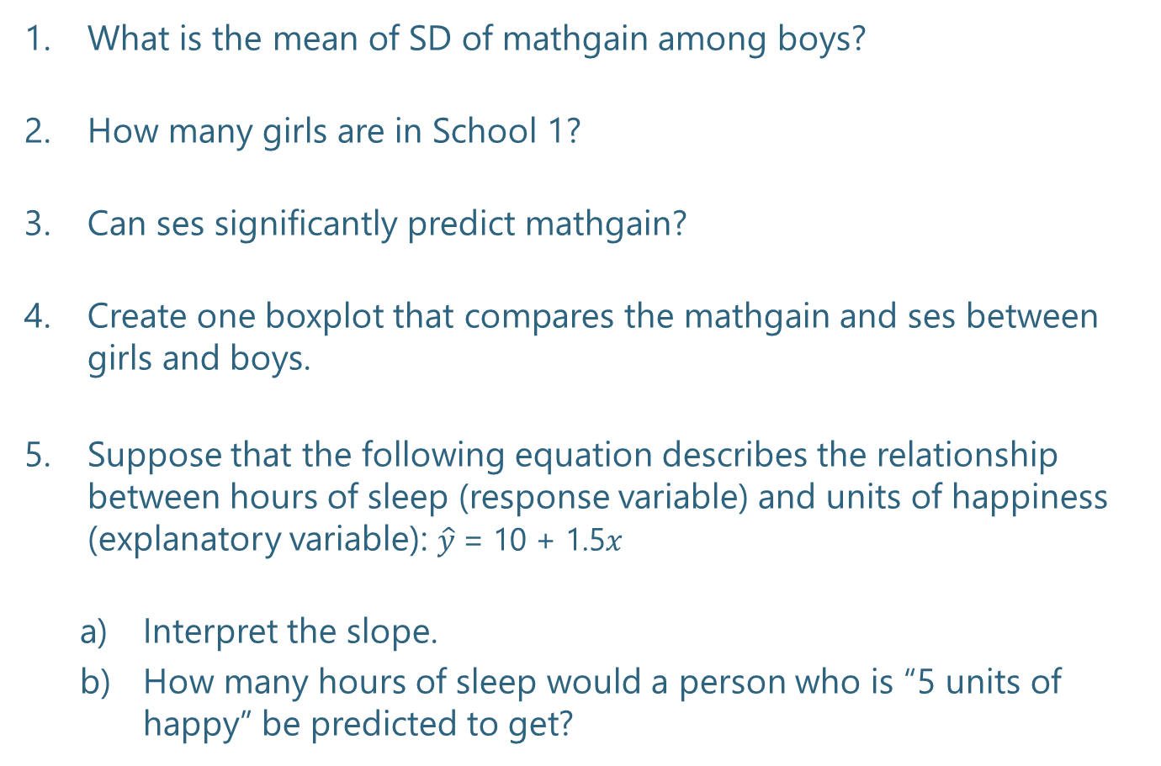
What is the mean of SD of mathgain among boys?
How many girls are in School 1?
Can ses signiﬁcantly predict mathgain?
Create one boxplot that compares the mathgain and ses between girls and boys.
Suppose that the following equation describes the relationship between hours of sleep (response variable) and units of happiness (explanatory variable): $\hat{y}$= 10 + 1.5$x$
Interpret the slope.
How many hours of sleep would a person who is “5 units of happy” be predicted to get?

Slide 35
Upcoming Assignments
Quiz 0:
01/26/2024
Homework 1 & 2:
02/4/2024
Project 1:
03/22/2024

